Slide 1
A PRESENTATION ON DATA & SIGNANL DIGITAL TRANSMISSION
PRESENTED BY
SHIKHA

Slide 2
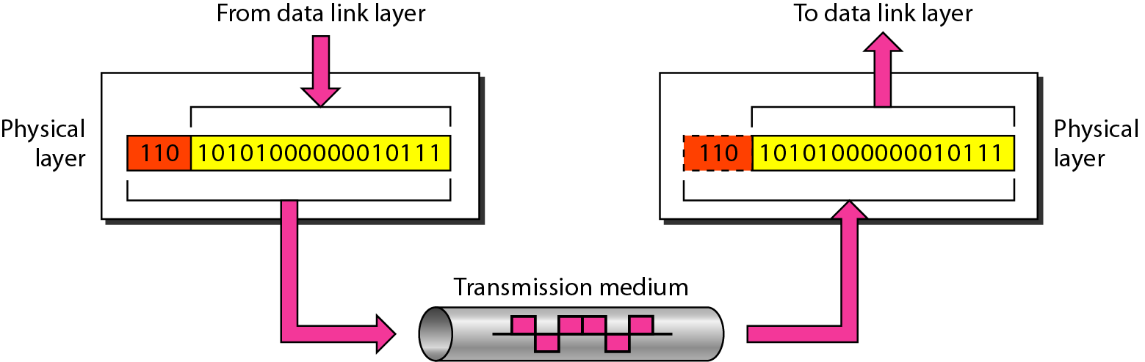
Physical layer
To be transmitted,
data must be transformed to electromagnetic signals.

Slide 3
ANALOG AND DIGITAL
Data can be analog or digital
Analog data refers to information that is continuous
Analog data take on continuous values
Analog signals can have an infinite number of values in a range
Digital data refers to information that has discrete states
Digital data take on discrete values
Digital signals can have only a limited number of values
In data communications, we commonly use
periodic analog signals and nonperiodic digital signals.

Slide 4
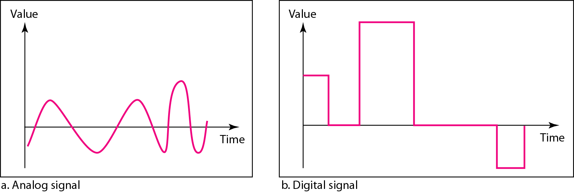
Comparison of analog and digital signals

Slide 5
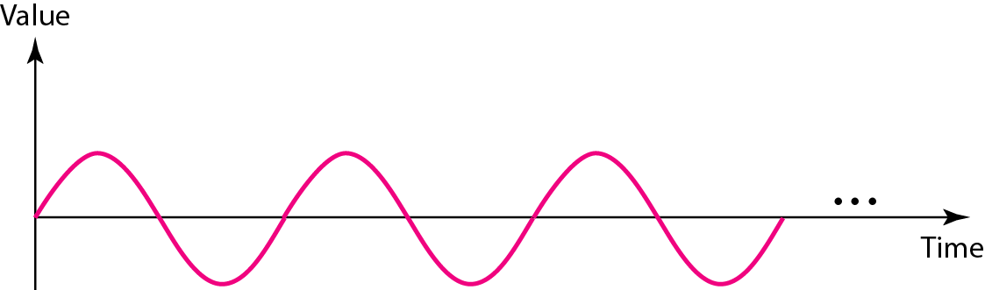
PERIODIC ANALOG SIGNALS
Periodic analog signals can be classified as simple or composite.
A simple periodic analog signal, a sine wave, cannot be decomposed into simpler signals.
A composite periodic analog signal is composed of multiple sine waves.

Slide 6
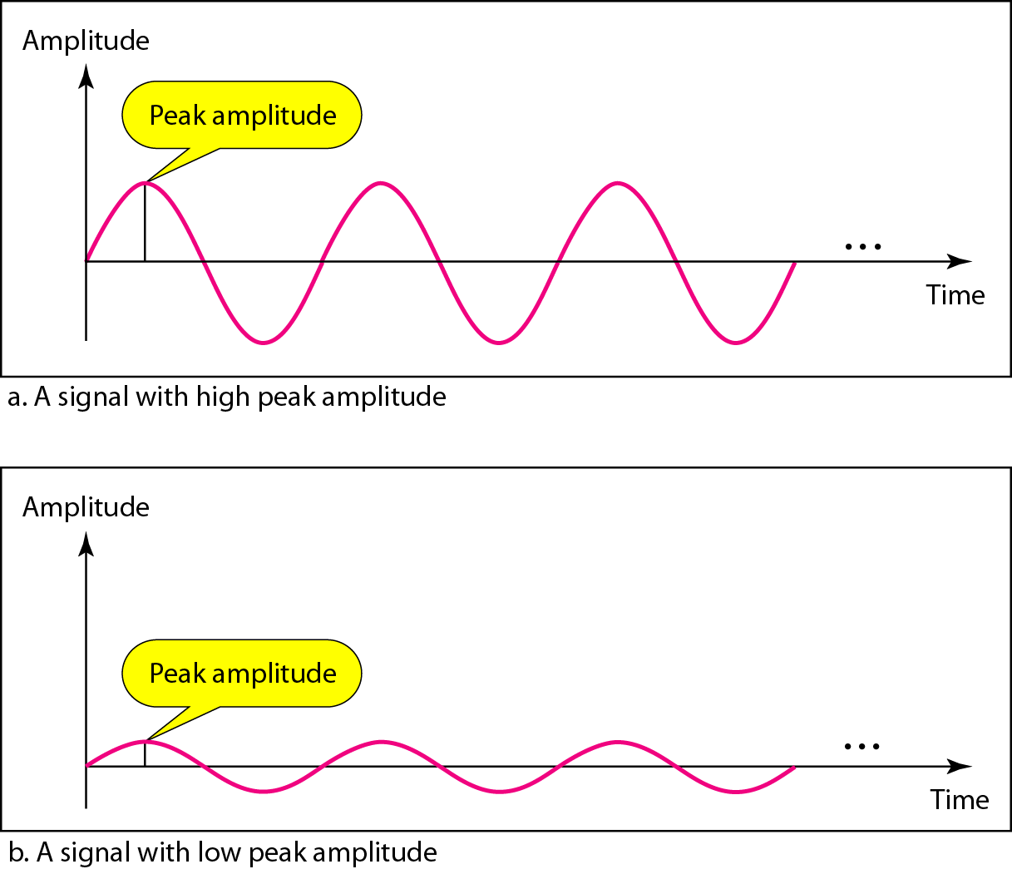
Signal amplitude

Slide 7
Frequency
Frequency is the rate of change with respect to time.
Change in a short span of time means high frequency.
Change over a long span of time means low frequency.
If a signal does not change at all, its frequency is zero
If a signal changes instantaneously, its frequency is infinite.

Slide 8

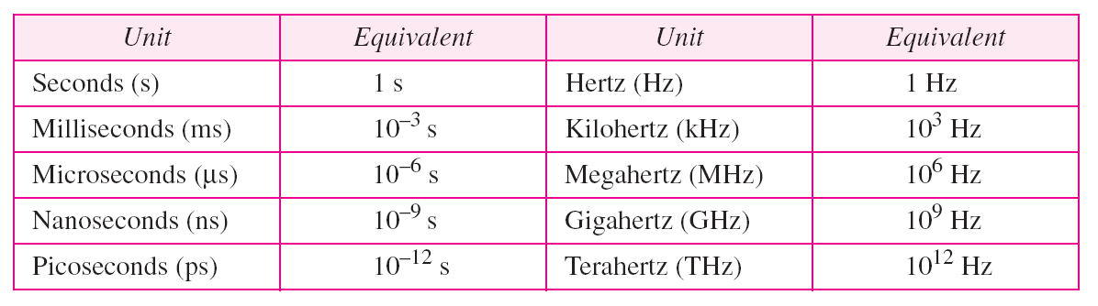
Frequency and Period
Frequency and period are the inverse of each other.
Units of period and frequency

Slide 9
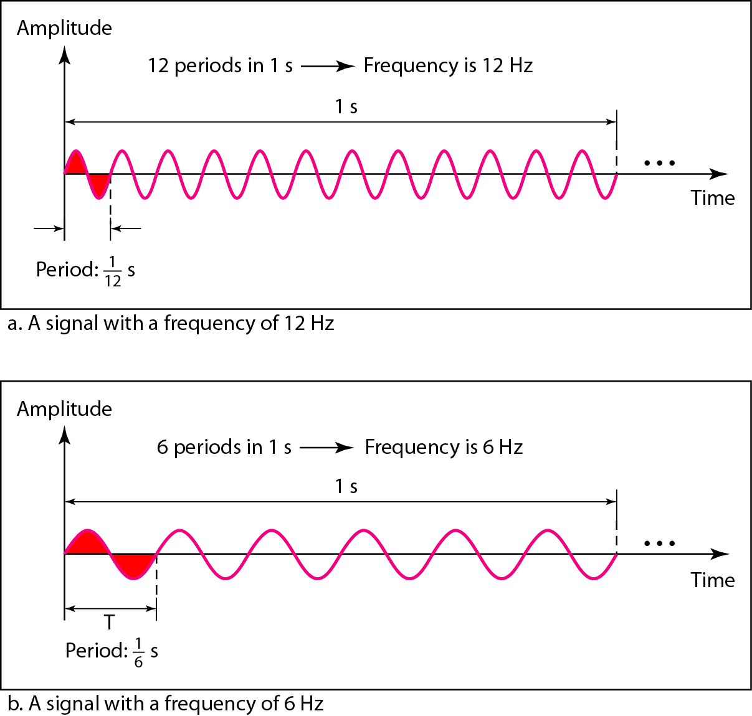
Two signals with the same amplitude, but different frequencies

Slide 10
Examples
The power we use at home has a frequency of 60 Hz. What is the period of this sine wave ?
The period of a signal is 100 ms. What is its frequency in kilohertz?

Slide 11
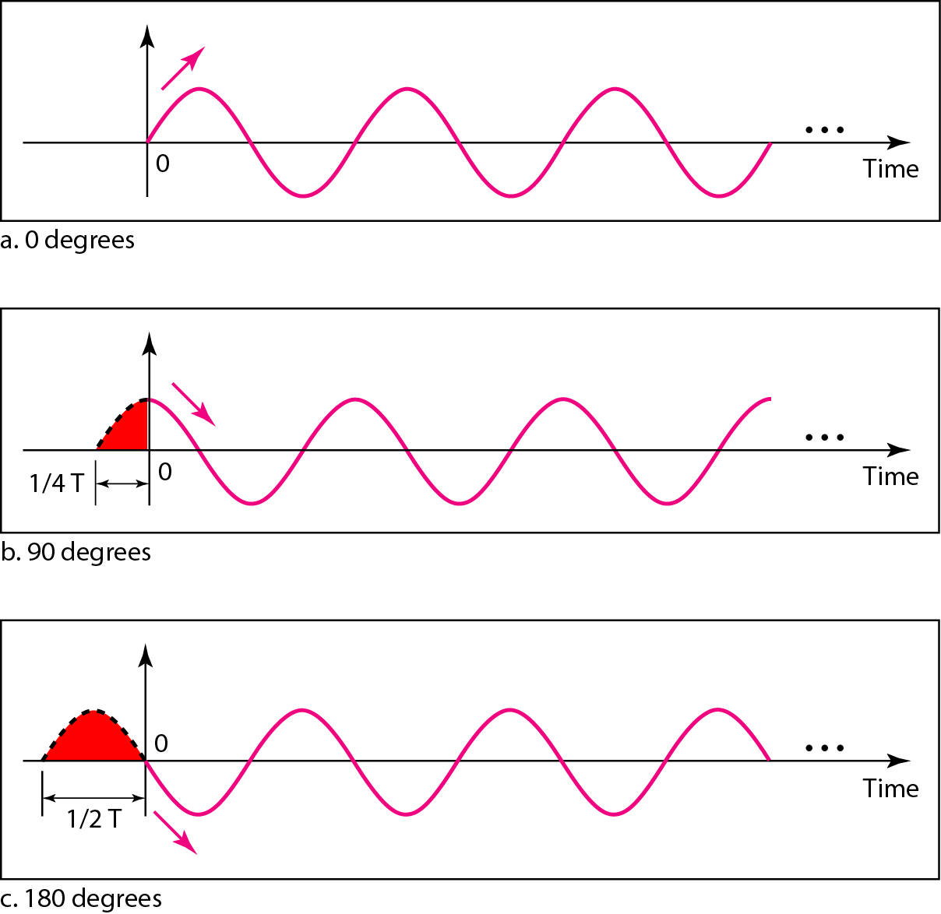
Phase
Phase describes the position of the waveform
relative to time 0
Three sine waves with the same amplitude and frequency, but different phases

Slide 12
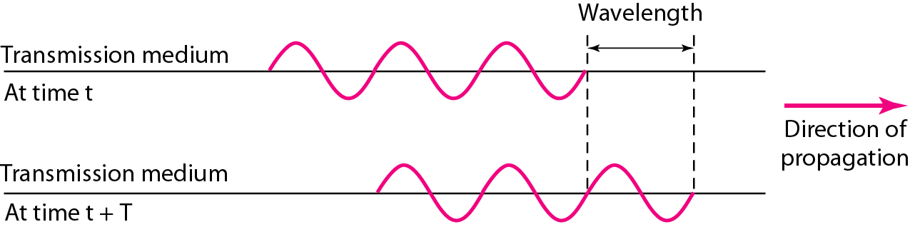
Wavelength and period
Wavelength = Propagation speed x Period
= Propagation speed / Frequency

Slide 13
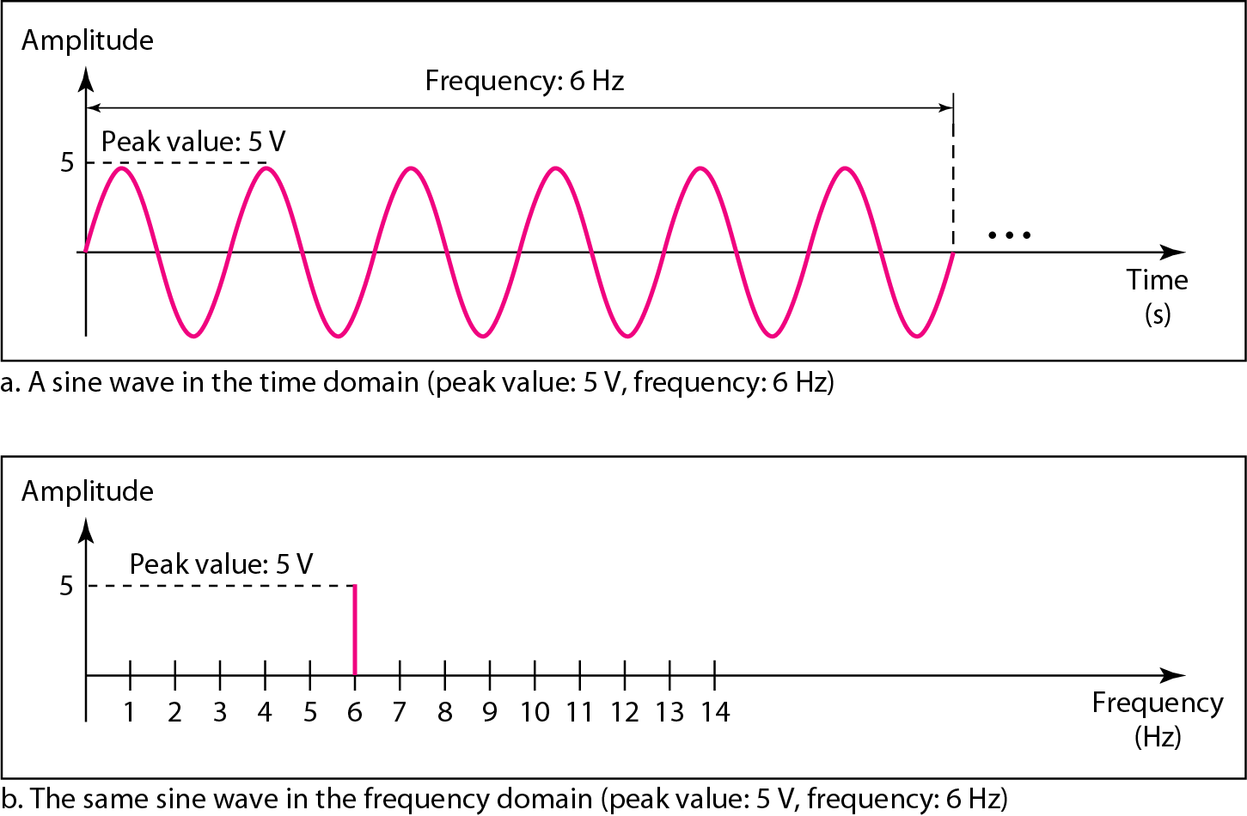
Time-domain and frequency-domain plots of a sine wave
A complete sine wave in the time domain can be represented by one single spike in the frequency domain.

Slide 14
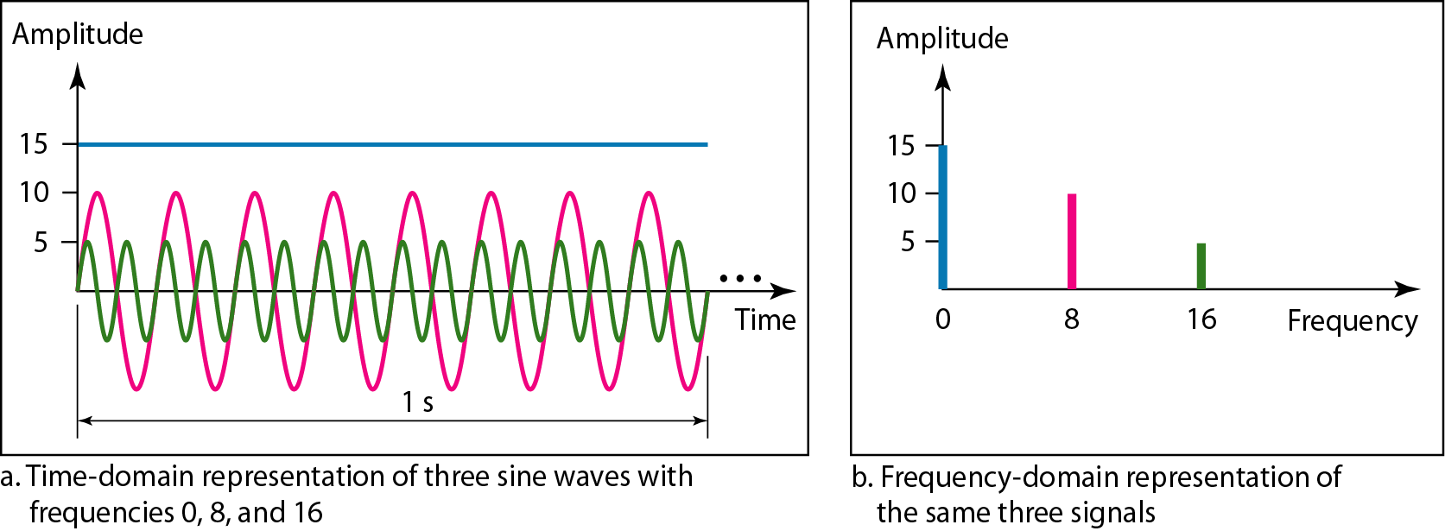
Frequency Domain
The frequency domain is more compact and useful when we are dealing with more than one sine wave.
A single-frequency sine wave is not useful in data communication
We need to send a composite signal, a signal made of many simple sine waves.

Slide 15
Fourier analysis
According to Fourier analysis,
any composite signal is a combination of simple sine waves with different frequencies, amplitudes, and phases.
If the composite signal is periodic, the decomposition gives a series of signals with discrete frequencies;
If the composite signal is nonperiodic, the decomposition gives a combination of sine waves with continuous frequencies.

Slide 16
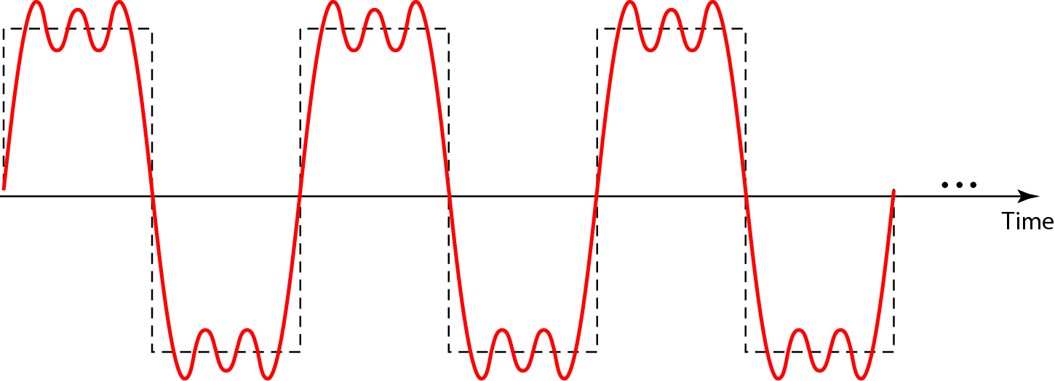
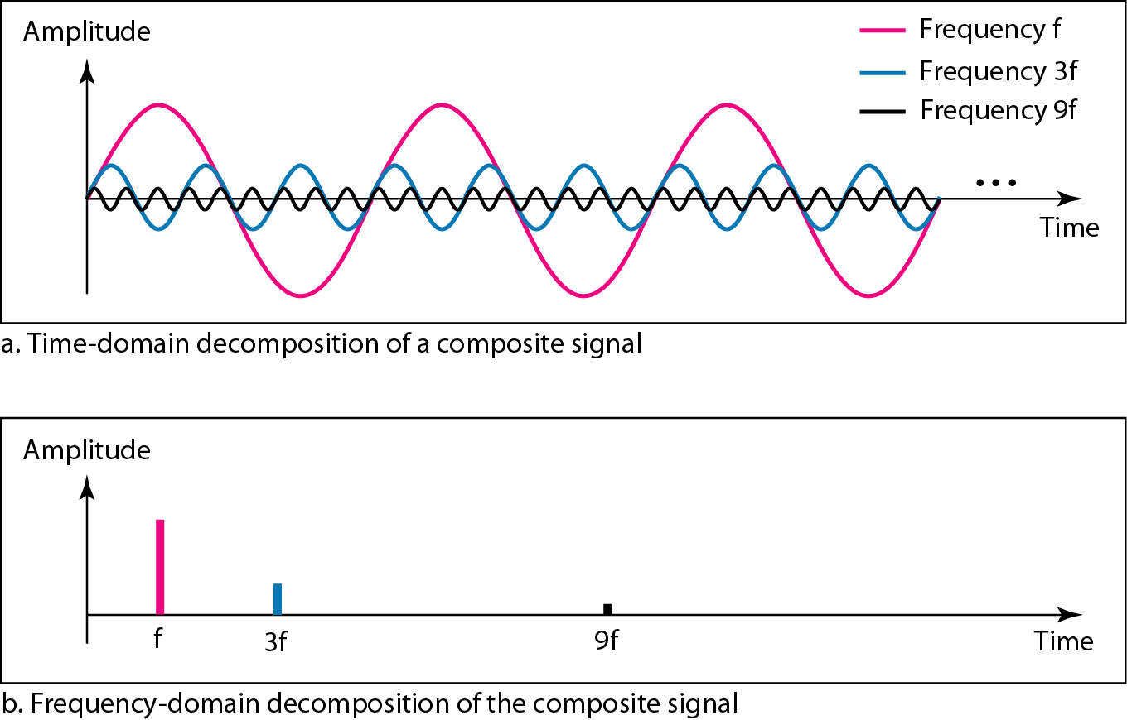
A composite periodic signal
Decomposition of the composite periodic signal in the time and frequency domains

Slide 17
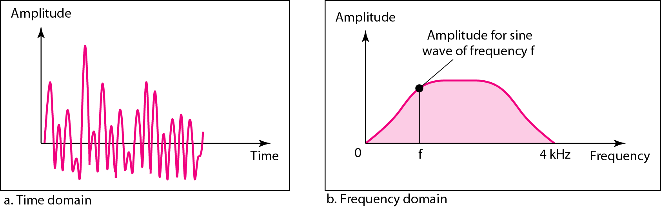
Time and frequency domains of a nonperiodic signal
A nonperiodic composite signal
It can be a signal created by a microphone or a telephone set when a word or two is pronounced.
In this case, the composite signal cannot be periodic
because that implies that we are repeating the same word or words with exactly the same tone.

Slide 18
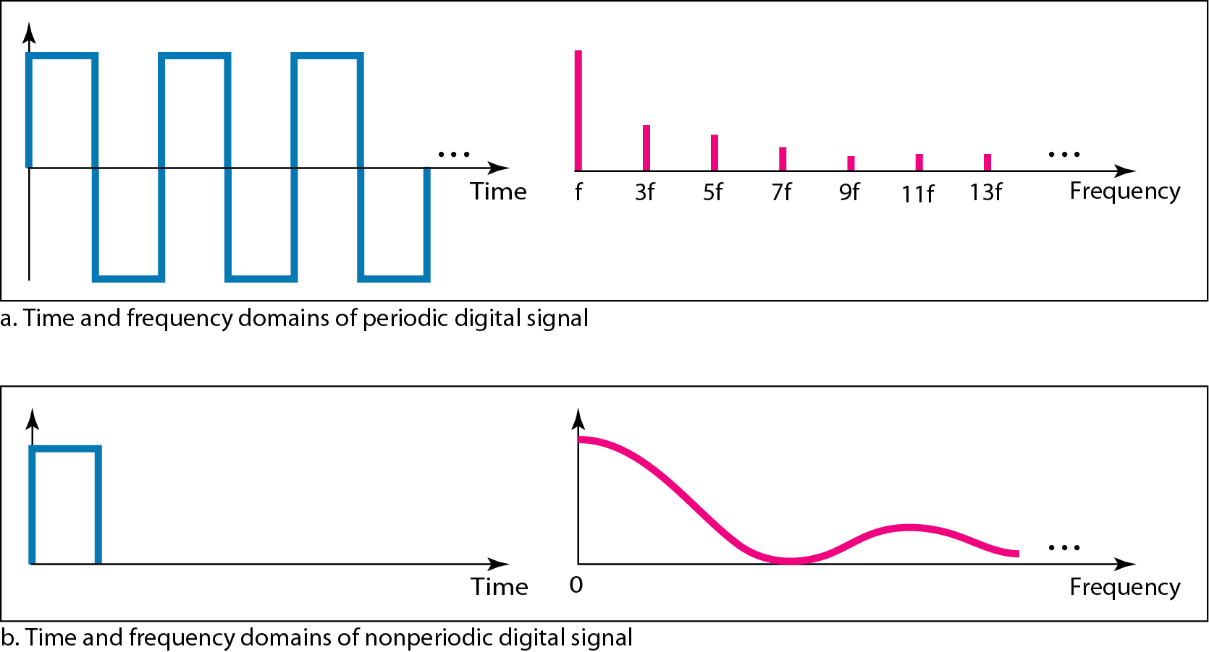
The time and frequency domains of periodic and
nonperiodic digital signals

Slide 19
DIGITAL SIGNALS
information can also be represented by a digital signal.
For example, a 1 can be encoded as a positive voltage and a 0 as zero voltage.
A digital signal can have more than two levels.
In this case, we can send more than 1 bit for each level.

Slide 20
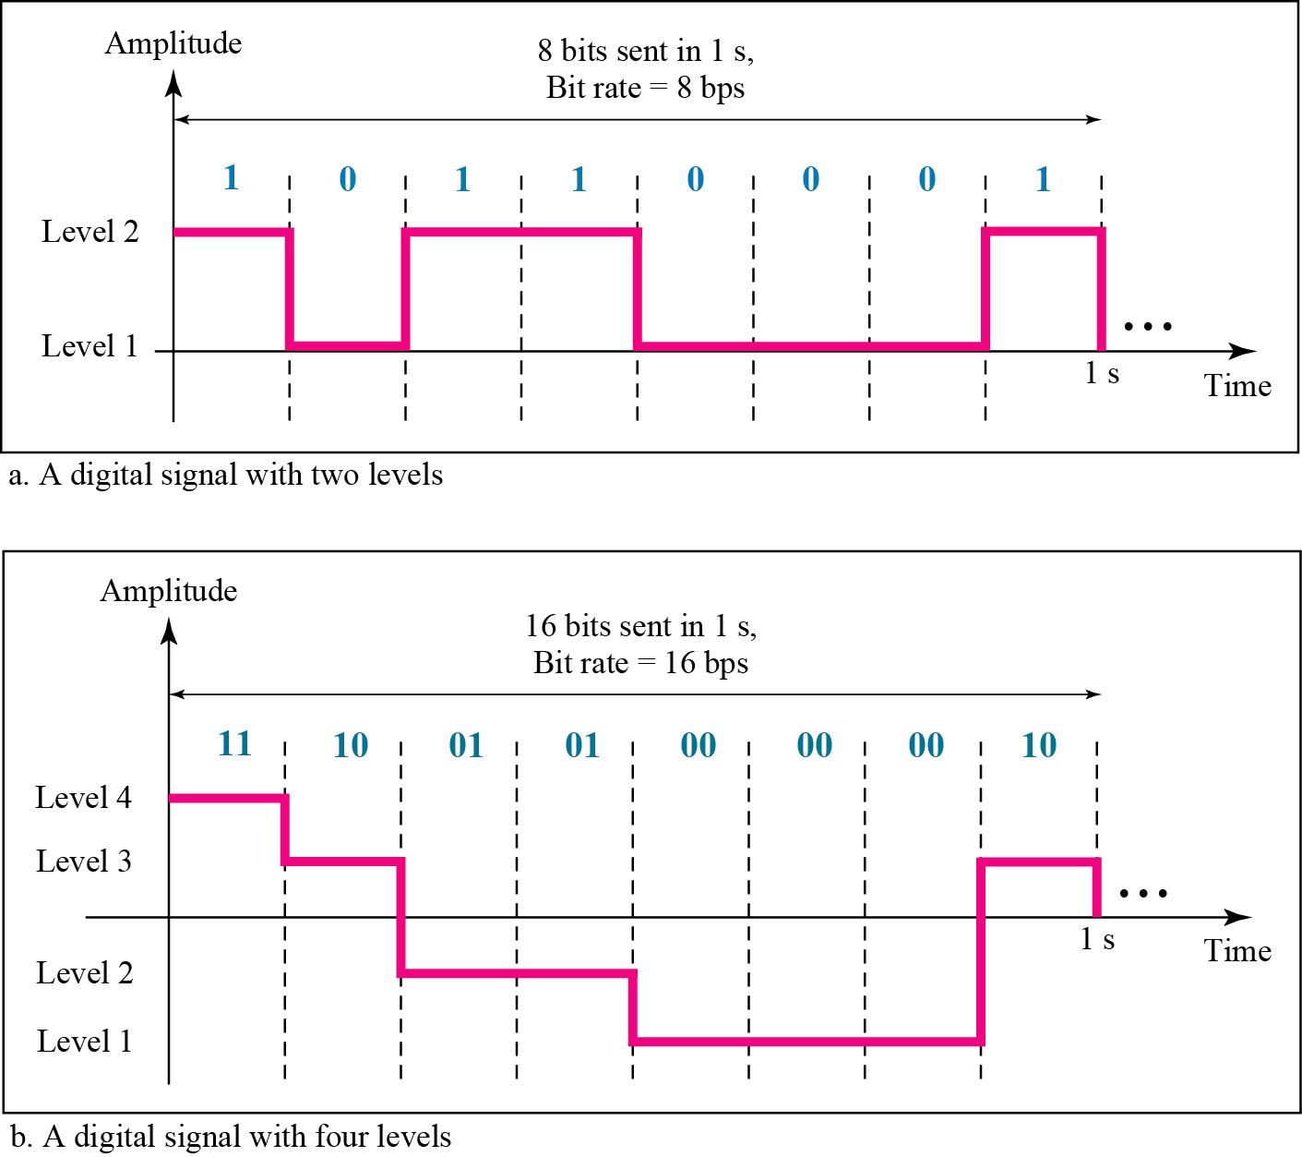
Two digital signals: one with two signal levels and
the other with four signal levels

Slide 21
Examples
A digital signal has 8 levels. How many bits are needed per level?
We calculate the number of bits from the formula

Slide 22
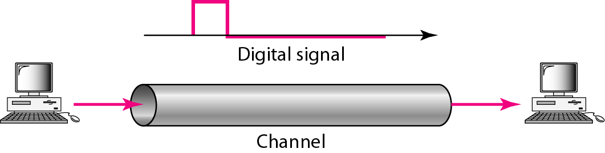
Baseband transmission
A digital signal is a composite analog signal with an infinite bandwidth.

Slide 23
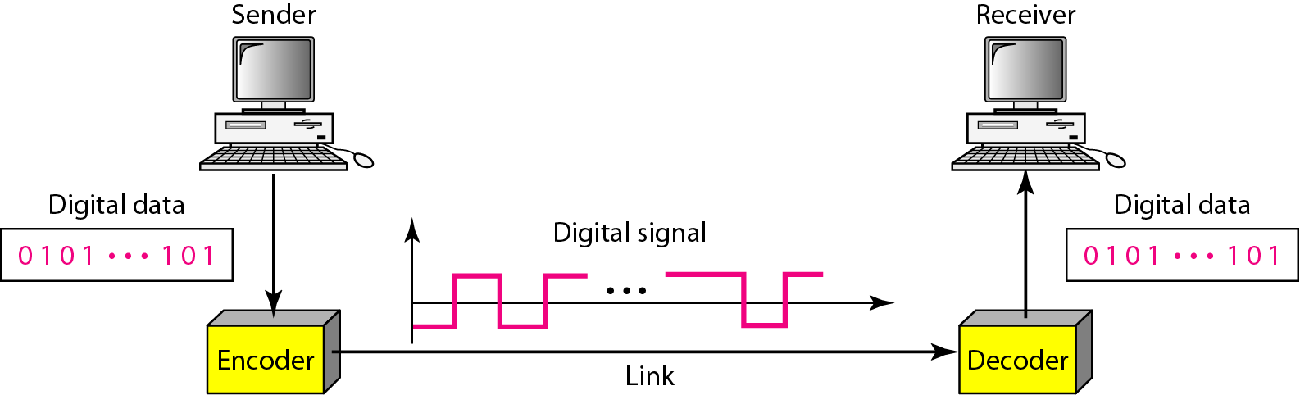
DIGITAL-TO-DIGITAL CONVERSION
We can represent digital data by using digital signals.
The conversion involves three techniques: line coding, block coding, and scrambling.
Line coding is always needed.
Block coding and scrambling may or may not be needed.
Line coding and decoding

Slide 24
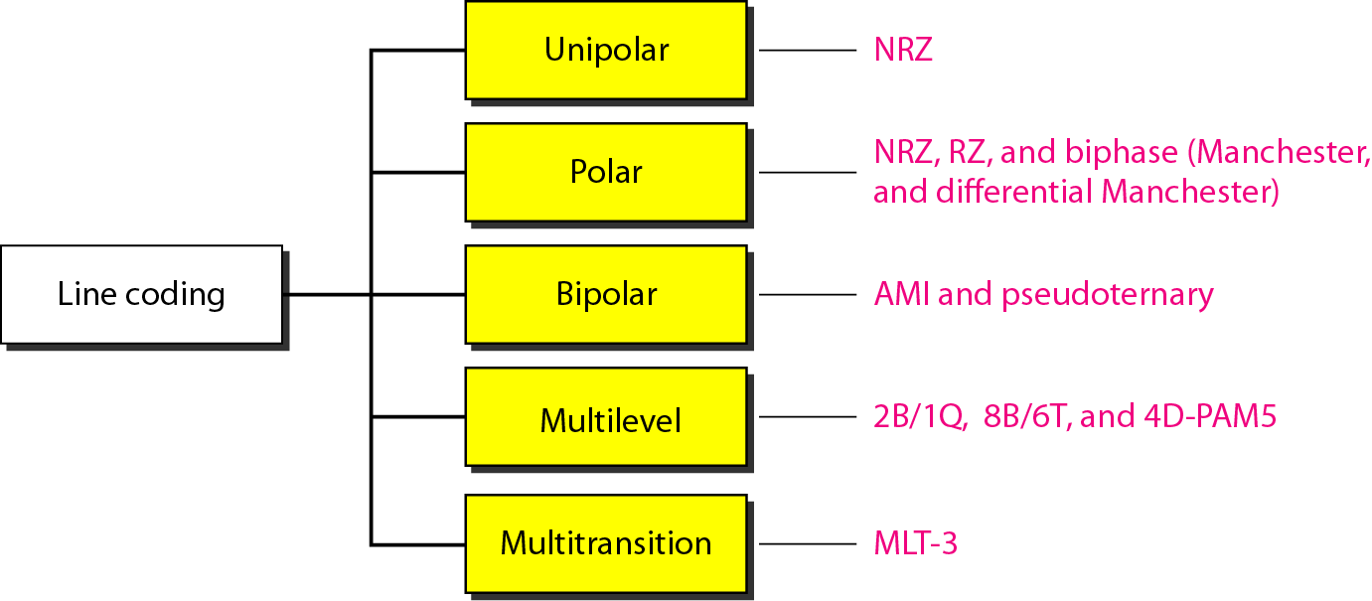
Line coding schemes

Slide 25
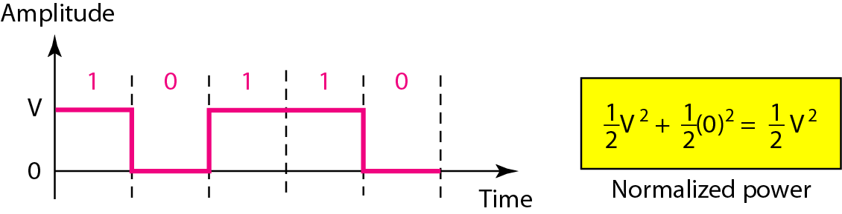
Unipolar NRZ scheme

Slide 26
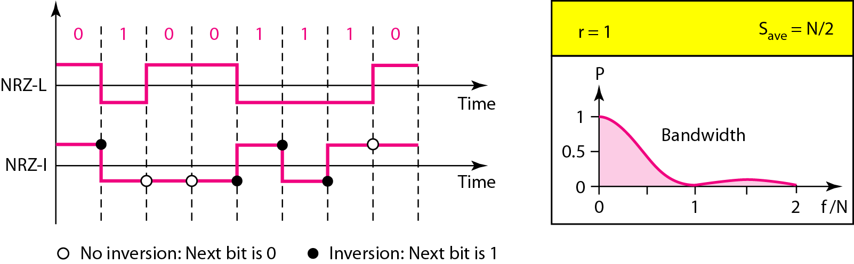
Polar NRZ-L and NRZ-I schemes
level of voltage determines value of the bit
inversion or lack of inversion determines value of the bit
Both have an average signal rate of N/2 Bd.
Both have a DC component problem.

Slide 27
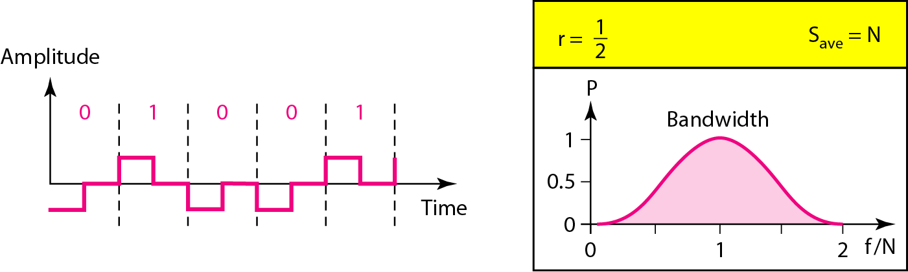
Polar RZ scheme

Slide 28
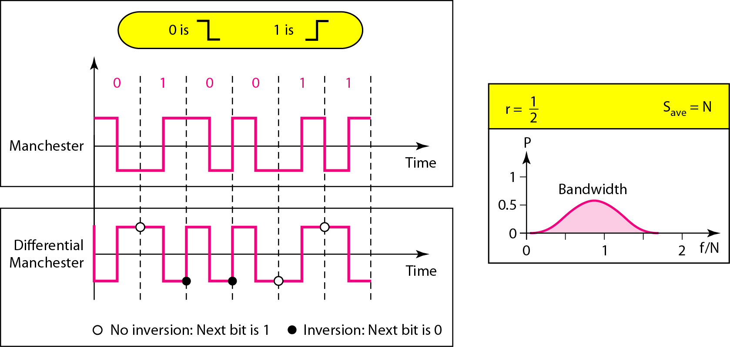
Polar bi phase: Manchester and differential Manchester schemes
Transition at the middle is used for synchronization
The minimum bandwidth is 2 times that of NRZ

Slide 29
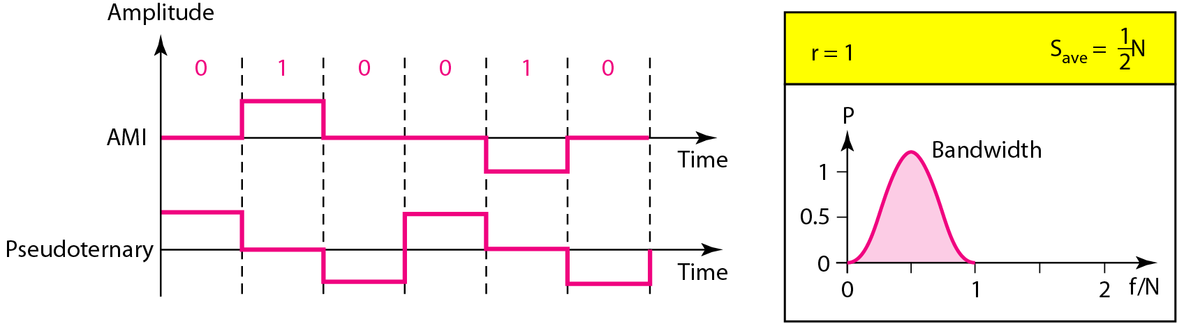
Bipolar schemes: AMI and pseudoternary
We use three levels: positive, zero, and negative.

